Slide 1
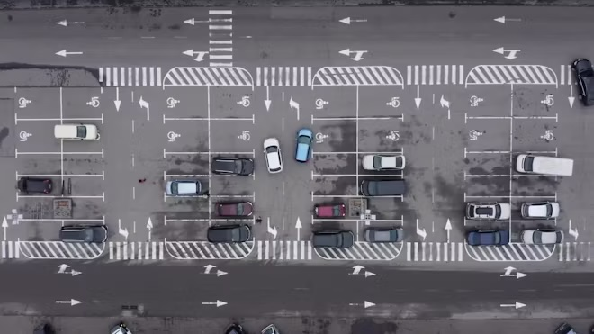
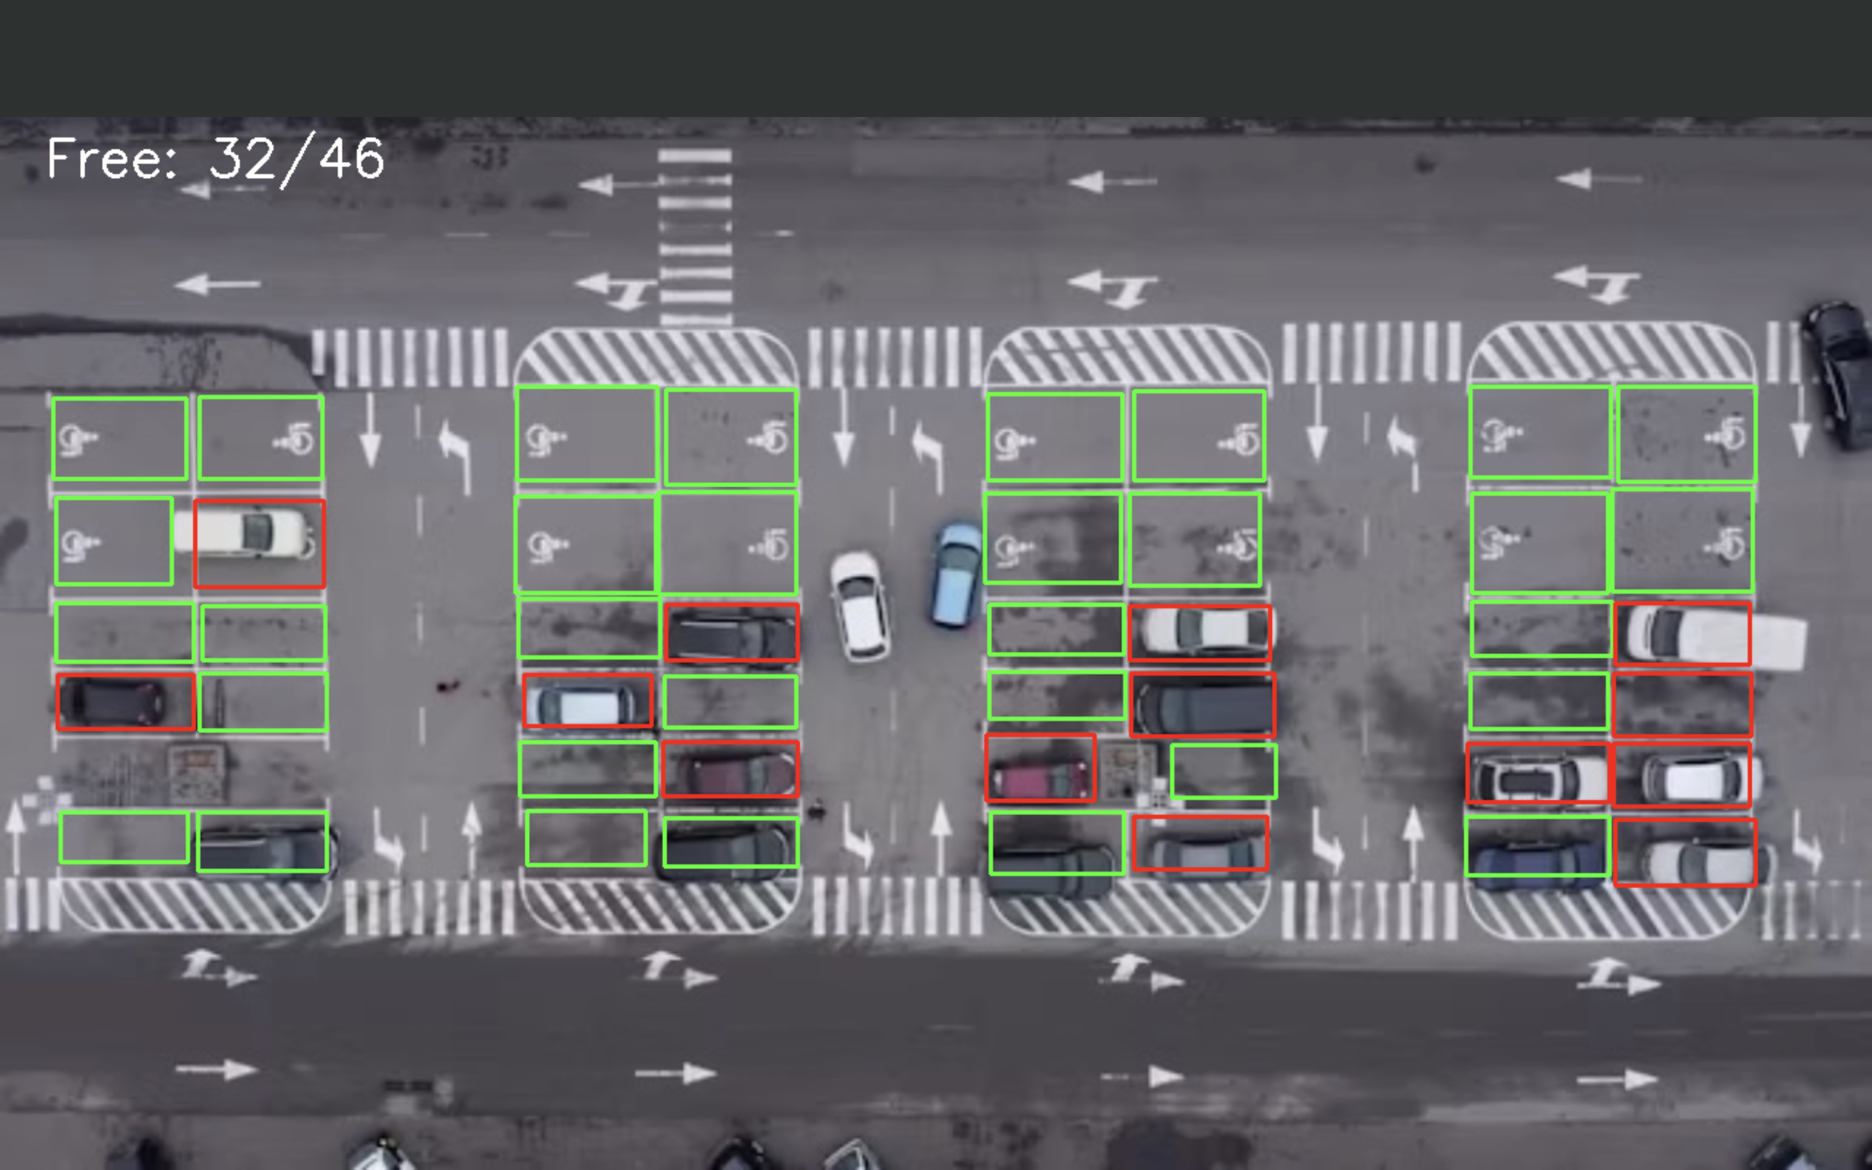
Computer_With_A_Vision
Team members: William Bolsen, Jacob Holt
Our project consists of a program that tracks the open parking spots in a given parking lot. We want our project to not only accurately identify which spots are open in an image but also be able to take a video feed and recognize when a spot becomes open or occupied. By the end of our project, we plan on using this program to detect open spots in a KSU parking lot.
This image was used to test whether our program worked and its accuracy. So far, it is about 77% accurate in identifying occupied spots.

